Slide 1
Group 28:
GPA Prediction
Deep Learning
Group 28
Notes:
Welcome to our presentation on leveraging deep learning to predict course outcomes.

Slide 2
Table of Contents
Member Introduction
Problem Motivation
Data and Metrics
Modeling Approach
Feature Analysis
Conclusion
Group 28
Slide Contributor: Wanting Mao, Tianyun Yuan, Max Xu, Wenqi Jia

Slide 3




Group 28 Members
Wanting Mao
Tianyun Yuan
Max Xu
Wenqi Jia
Group 28
Slide Contributor: Wanting Mao, Tianyun Yuan, Max Xu, Wenqi Jia
Notes:
We are Group 28: Wanting Mao, Tianyun Yuan, Max Xu, and Wenqi Jia. Today, we’ll explore how we addressed the challenges students face when choosing courses and how our model can make their decisions more informed.

Slide 4
Problem Motivation
Choosing the right course is critical for students
Hard to align with course goals and workloads
Harsh grading curves impact GPA
…
Current course review provides historical data but lacks reliable prediction on students’ performance
Group 28
Slide Contributor: Wanting Mao, Tianyun Yuan, Max Xu, Wenqi Jia
Notes:
Choosing the right course is essential but often difficult for students. Misaligned goals, harsh grading curves, and a lack of predictive tools in existing course reviews create stress and uncertainty. We aim to solve this by predicting average GPAs using historical data, empowering students to select courses that best fit their needs while minimizing academic stress.

Slide 5
Problem Motivation
Our Plan
Leverage deep learning and historical academic data to predict average GPAs for specific classes
Impact
Help students make informed course decisions
Reduce stress and improve academic outcomes
Foster a more personalized and fulfilling educational experience
Group 28
Slide Contributor: Wanting Mao, Tianyun Yuan, Max Xu, Wenqi Jia
Notes:
Our plan is to leverage deep learning and historical academic data to provide reliable GPA predictions. This will help students make better decisions, reduce stress, and create a more personalized academic experience. We want to foster an environment where students feel confident about their choices, leading to improved academic outcomes.

Slide 6
Technical Data Challenges
Missing data:
primary instructor == NULL, solved by including a new category “NA” for such course
Imbalanced data:
Subject distribution is long-tailed such that most students pass.
Sparse data:
~75% datapoints have grade between A and B. Used sparse matrix data structure to reduce computational overhead.
Categorical data:
Lacks inherent order or numeric meaning. Addressed with one-hot encoding of specific categorical features.
Group 28
Slide Contributor: Wanting Mao, Tianyun Yuan, Max Xu, Wenqi Jia
Notes:
Wanting

Slide 7
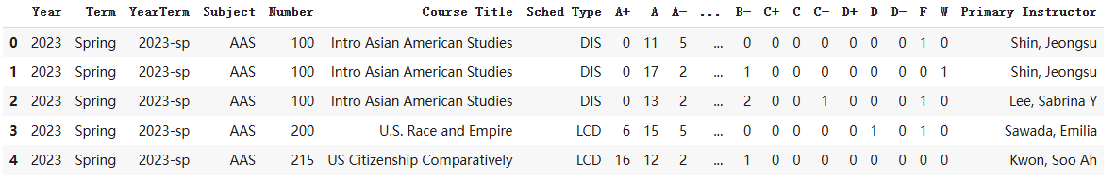
Sample Data w/ Features Explained
Subject: course subjects, CS, IE etc.
Course Level: Number//100, {1, 2, 3, 4, 5}
Sched Type: Discussion, Lecture etc.
Primary Instructor: course instructor
Class Size: number of students received letter grade.
Group 28
Slide Contributor: Wanting Mao, Tianyun Yuan, Max Xu, Wenqi Jia
Notes:
Wanting

Slide 8
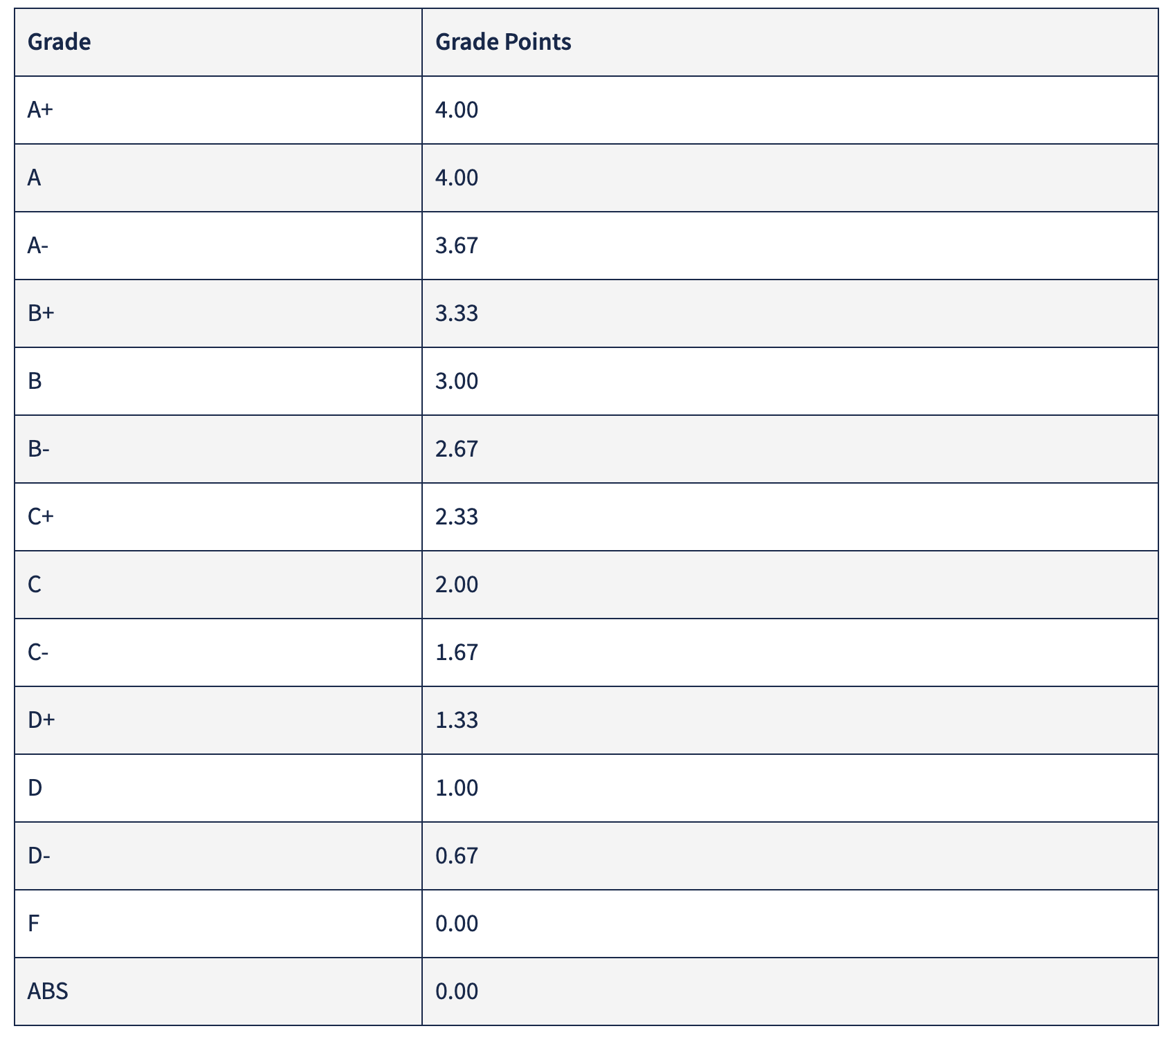
Data Features to Predict
Average GPA:
(number of students with A+ * 4.0
+
number of students with A * 4.0
+
number of students with A- * 3.67 + …
number of students with F * 0.0)
/Class Size
Group 28
Slide Contributor: Wanting Mao, Tianyun Yuan, Max Xu, Wenqi Jia
Notes:
Wanting

Slide 9
Metrics
R² meaning:
The R-squared value, also known as the coefficient of determination, is a statistical measure that represents how well the independent variables in a model explain the variance in the dependent variable.
Group 28
Slide Contributor: Wanting Mao, Tianyun Yuan, Max Xu, Wenqi Jia

Slide 10
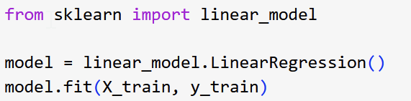
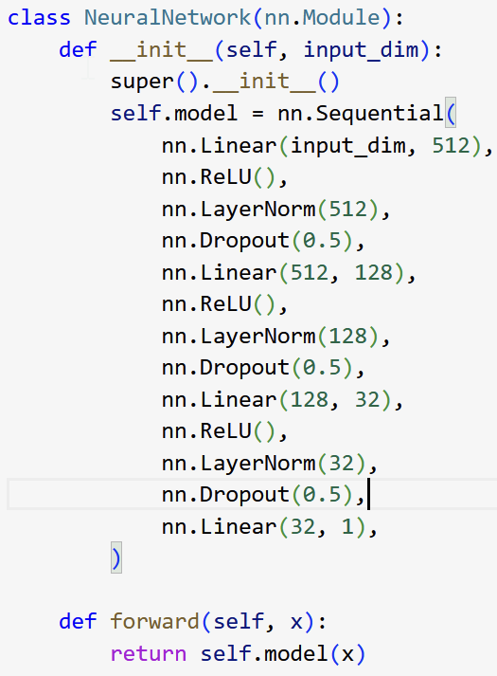
Model Benchmarks and Training
Linear Regression Model
Scikit-Learn
Trained to minimize the residual sum of squares
Deep Learning Model
Pytorch
Mix of linear, relu, layer norm, dropout layers
Group 28
Slide Contributor: Wanting Mao, Tianyun Yuan, Max Xu, Wenqi Jia

Slide 11
DL Model Hyperparmeter Tuning
Optimizers: [Adam, SGD, RMS Prop]
Batch Size: [8, 16, 32, 64, 128]
Learning Rates: [0.1, 0.01, 0.001]
Group 28
Slide Contributor: Wanting Mao, Tianyun Yuan, Max Xu, Wenqi Jia

Slide 12
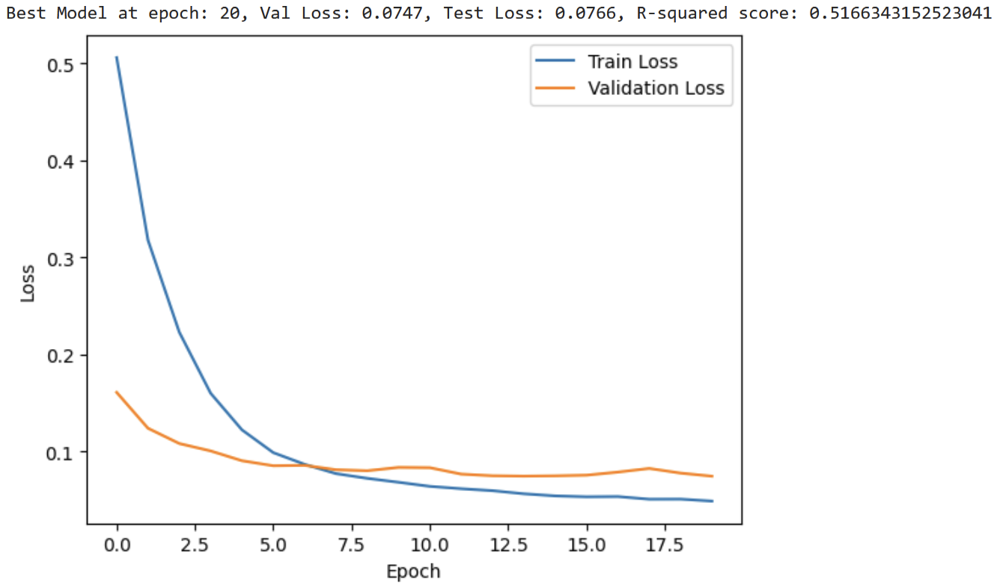
DL Model Hyperparmeter Tuning
Optimizers: [Adam, SGD, RMS Prop]
Batch Size: [8, 16, 32, 64, 128]
Learning Rates: [0.1, 0.01, 0.001]
Group 28
Slide Contributor: Wanting Mao, Tianyun Yuan, Max Xu, Wenqi Jia

Slide 13
Results
Modeling Approach | R² Value
Deep Learning Model | 0.517
Linear Regression Model | 0.483
Our deep learning model outperforms the linear regression model!
Group 28
Slide Contributor: Wanting Mao, Tianyun Yuan, Max Xu, Wenqi Jia

Slide 14
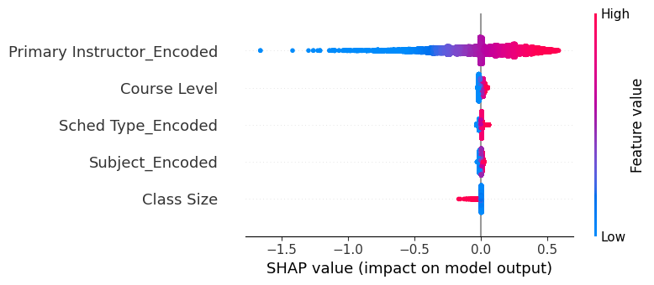
SHAP Values
SHAP analysis works by calculating the contribution of each feature to a model's prediction using game-theoretic values, considering all possible feature combinations to fairly distribute the prediction's impact.
Group 28
Slide Contributor: Wanting Mao, Tianyun Yuan, Max Xu, Wenqi Jia

Slide 15
SHAP Values - Instructor
Higher encoded instructor values → higher SHAP values → positive contribution.
Instructors have the largest impact on model predictions.
Group 28
Slide Contributor: Wanting Mao, Tianyun Yuan, Max Xu, Wenqi Jia

Slide 16
Feature Permutation
Feature permutation evaluates a feature's importance by randomly shuffling its values and measuring the drop in the model's performance, highlighting how much the feature contributes to predictions.
Feature Being Permuted | Average R² Value
Instructor | 0.19
Course Level | 0.51
Subject Type | 0.52
Schedule Type | 0.53
Class Size | 0.54
Group 28
Slide Contributor: Wanting Mao, Tianyun Yuan, Max Xu, Wenqi Jia

Slide 17
Feature Permutation
Feature permutation evaluates a feature's importance by randomly shuffling its values and measuring the drop in the model's performance, highlighting how much the feature contributes to predictions.
Feature Being Permuted | Average R² Value
Instructor | 0.19
Course Level | 0.51
Subject Type | 0.52
Schedule Type | 0.53
Class Size | 0.54
Instructor remains to be the most important feature, with the greatest drop in performance when shuffled …
Group 28
Slide Contributor: Wanting Mao, Tianyun Yuan, Max Xu, Wenqi Jia

Slide 18
Conclusion
Optimized Model: After hyperparameter tuning, the deep learning model achieved a R² score of 0.52, ensuring accurate GPA predictions.
Feature Selection: Our SHAP analysis and Feature Permutation analysis help us enhance interpretability, identifying the most critical features to be the instructor.
Key Insight: The deep learning model effectively captures complex relationships and interactions, providing a robust tool for students to make informed course selections.
Group 28
Slide Contributor: Wanting Mao, Tianyun Yuan, Max Xu, Wenqi Jia

Slide 19
Thank You
THANK YOU!
Department / Unit

Slide 20
SHAP Values - Course Level
Higher course levels → greater impact on predictions.
Lower course levels → minimal effect.
Group 28
Slide Contributor: Wanting Mao, Tianyun Yuan, Max Xu, Wenqi Jia

Slide 21
SHAP Values - Schedule Type
Limited impact overall except for datapoints with high values.
Group 28
Slide Contributor: Wanting Mao, Tianyun Yuan, Max Xu, Wenqi Jia

Slide 22
SHAP Values - Subject Level
Similar effect as instructors but with less influence on the model.
Group 28
Slide Contributor: Wanting Mao, Tianyun Yuan, Max Xu, Wenqi Jia

Slide 23
SHAP Values - Subject Type
i.e. CS vs IE vs ENG
Similar effect as instructors but with less influence on the model.
Group 28
Slide Contributor: Wanting Mao, Tianyun Yuan, Max Xu, Wenqi Jia

Slide 24
SHAP Values - Class Size
Larger class sizes → negative impact on predictions.
Smaller class sizes → minimal effect.
Group 28
Slide Contributor: Wanting Mao, Tianyun Yuan, Max Xu, Wenqi Jia

